Slide 1
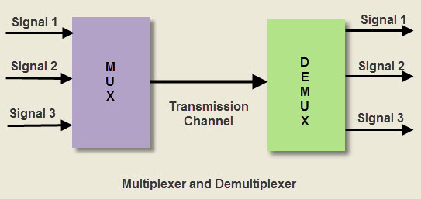
Multiplexers (MUX) and De-multiplexers (DEMUX Multiplexers (MUX) and De-multiplexers (DEMUX) are essential combinational logic circuits used in digital electronics for data transmission and communication systems.

Slide 2
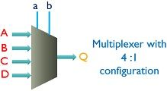
What is a Multiplexer (MUX)?
A multiplexer (MUX) is a combinational circuit that selects one of several input signals and forwards it to a single output line. It acts as a data selector.

Slide 3
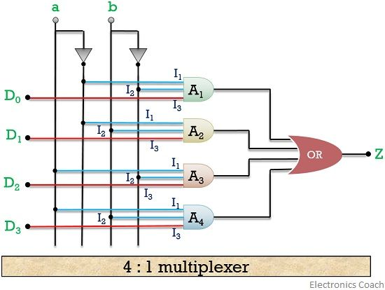

Slide 4
Types of Multiplexers
2:1 Multiplexer – Selects one of the two inputs based on a single select line.
4:1 Multiplexer – Selects one of four inputs with two select lines.
8:1 Multiplexer – Uses three select lines to choose one among eight
inputs.
16:1 Multiplexer – Uses four select lines to select one of sixteen inputs.

Slide 5
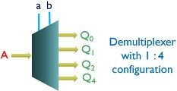
De-multiplexer
De-multiplexer basically reverses the operation of a multiplexer. It switches a single input to several outputs.

Slide 6
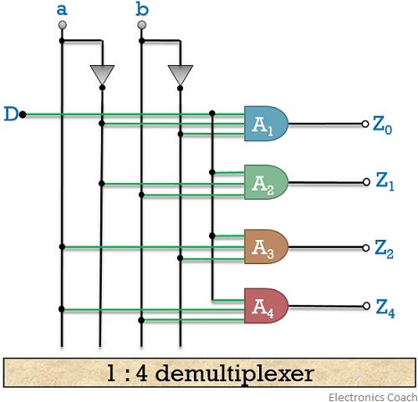

Slide 7
Applications of Multiplexers and DE-Multiplexers
Multiplexers find application in various fields such as telecommunications,
data communication systems,
analog-to-digital converters,
and memory addressing.
De-multiplexer are used in several input and output devices for
data routing.
digital control systems
data transmission in systems.

